Slide 1
Computer Networks
MAC -Random Access
S.V.Jansi Rani
Associate Professor / CSE

Slide 2
Agenda
ALOHA
CSMA
CSMA -CD
CSMA - CD

Slide 3



Slide 4
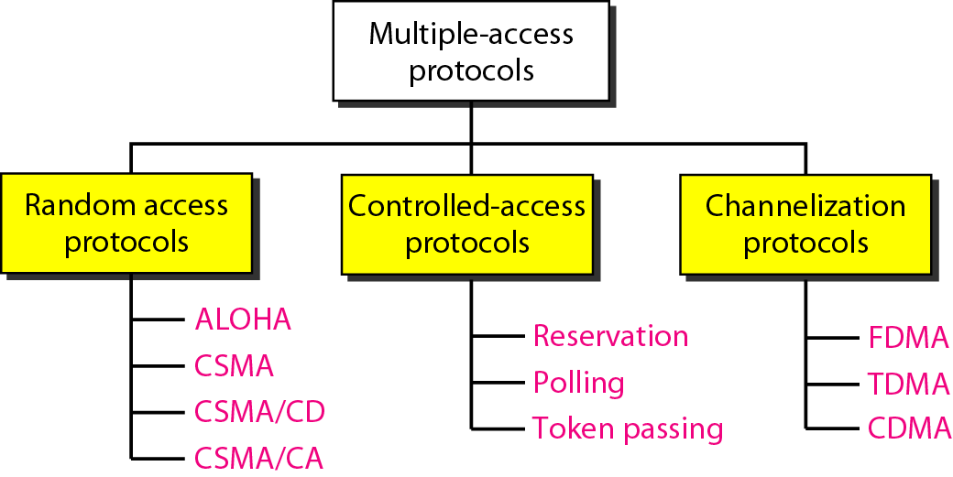
Taxonomy of Multiple-Access / Medium Access protocols

Slide 5
RANDOM ACCESS
In random access or contention methods, no station is superior to another station and none is assigned the control over another.
No station permits, or does not permit, another station to send.
Station that has data to send uses a procedure defined by the protocol to make a decision on whether or not to send.
No scheduled time - random transmission
Stations compete with one another - contention

Slide 6
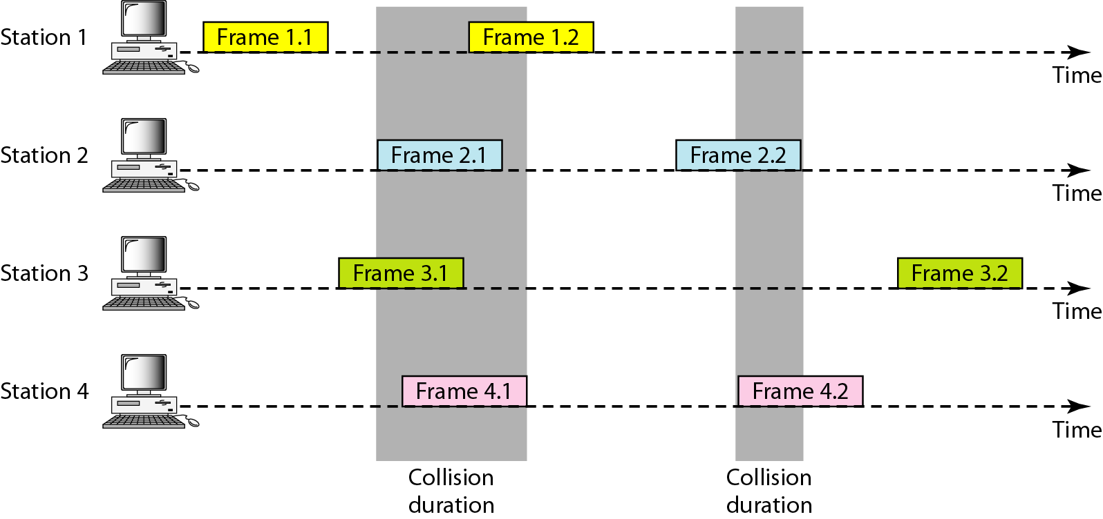
Frames in a pure ALOHA network

Slide 7
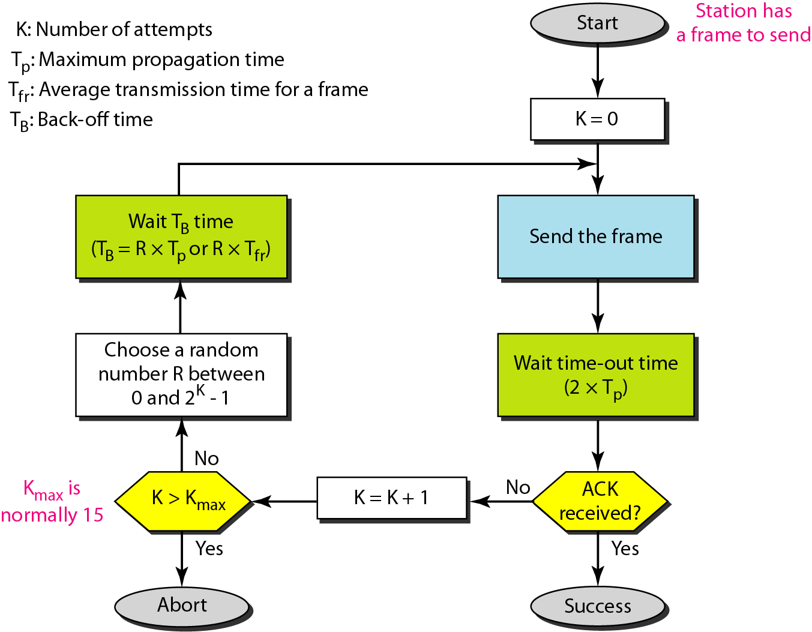
Procedure for pure ALOHA protocol

Slide 8
Example
The stations on a wireless ALOHA network are a maximum of 600 km apart. If we assume that signals propagate at 3 × 10⁸ m/s, we find
T_{p} = (600 × 10³ ) / (3 × 10⁸ ) = 2 ms.
Find the value of T_{B} for different values of K.
For K = 1, the range is {0, 1}. The station needs to| generate a random number with a value of 0 or 1. This means that T_{B} is either 0 ms (0 × 2) or 2 ms (1 × 2), based on the outcome of the random variable.

Slide 9
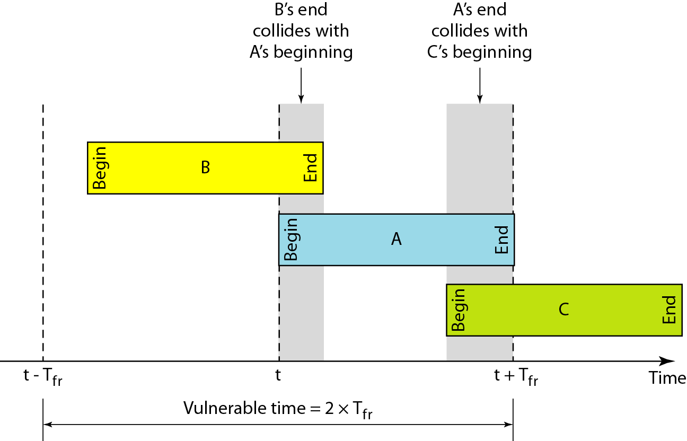
Vulnerable time for pure ALOHA protocol
T_{fr} - avg frame tr time

Slide 10
Example
A pure ALOHA network transmits 200-bit frames on a shared channel of 200 kbps. What is the requirement to make this frame collision-free?
Solution
T_{fr} = 200 bits/200 kbps or 1 ms.
Vulnerable time = 2 × 1 ms = 2 ms.
This means no station should send later than 1 ms before this station starts transmission and no station should start sending during the one 1-ms period that this station is sending.

Slide 11

Note
The throughput for pure ALOHA is S = G × e ^{−2G} .
The maximum throughput
S_{max} = 0.184 when G= (1/2).
G the average number of frames generated by the system during one frame transmission time

Slide 12
Example
A pure ALOHA network transmits 200-bit frames on a shared channel of 200 kbps. What is the throughput if the system (all stations together) produces
a. 1000 frames per second b. 500 frames per second
c. 250 frames per second.
The frame transmission time is 200/200 kbps or 1 ms.
a. If the system creates 1000 frames per second, this is 1 frame per millisecond. Then G=1. In this case S = G× e^{−2 G} or S = 0.135 (13.5 percent). This means that the throughput is 1000 × 0.135 = 135 frames. Only 135 frames out of 1000 will probably survive.

Slide 13
If the system creates 500 frames per second, this is (1/2) frame per millisecond. The load is (1/2). In this case S = G × e ^{−2G} or S = 0.184 (18.4 percent). This means that the throughput is 500 × 0.184 = 92 and that only 92 frames out of 500 will probably survive. Note that this is the maximum throughput case, percentagewise.
If the system creates 250 frames per second, this is 1/4 frame per millisecond. The load is (1/4). In this case S = G × e −^{2G} or S = 0.152 (15.2 percent). This means that the throughput is 250 × 0.152 = 38. Only 38 frames out of 250 will probably survive.

Slide 14
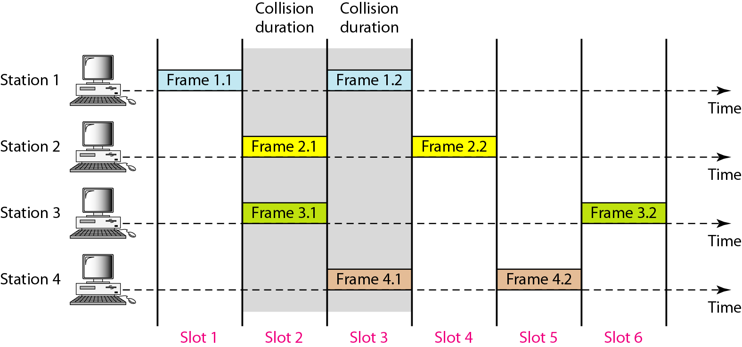
Frames in a slotted ALOHA network

Slide 15
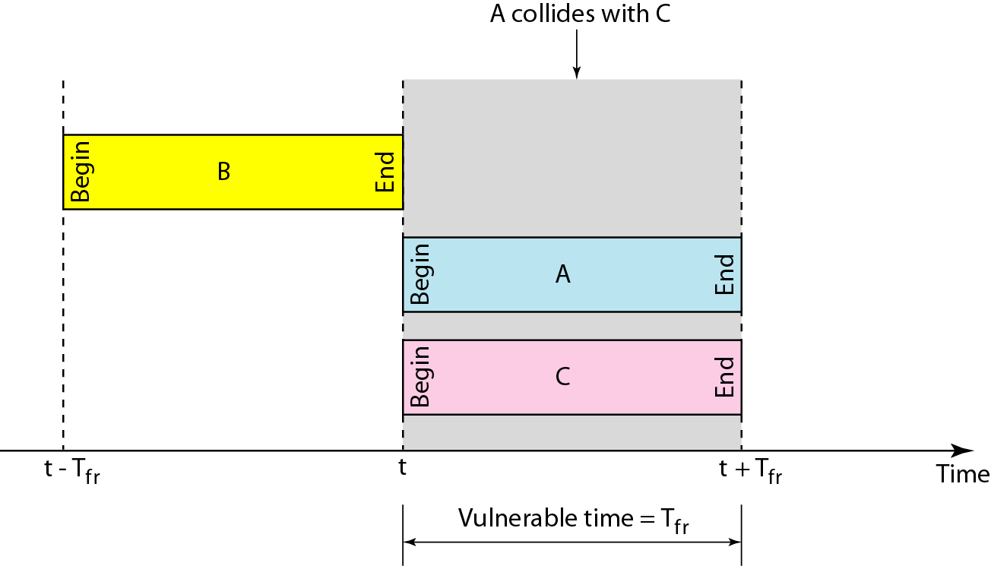
Vulnerable time for slotted ALOHA protocol

Slide 16
Note
The throughput for slotted ALOHA is S = G × e^{−G} .
The maximum throughput S_{max} = 0.368 when G = 1.

Slide 17
EXAMPLE
A slotted ALOHA network transmits 200-bit frames on a shared channel of 200 kbps. What is the throughput if the system (all stations together) produces
a. 1000 frames per second b. 500 frames per second
c. 250 frames per second.
Solution
The frame transmission time is 200/200 kbps or 1 ms.
a. If the system creates 1000 frames per second, this is 1 frame per millisecond. The load is 1. In this case S = G× e^{−G} or S = 0.368 (36.8 percent). This means that the throughput is 1000 × 0.0368 = 368 frames. Only 386 frames out of 1000 will probably survive.

Slide 18
EXAMPLE
If the system creates 500 frames per second, this is (1/2) frame per millisecond. The load is (1/2). In this case S = G × e^{−G} or S = 0.303 (30.3 percent). This means that the throughput is 500 × 0.0303 = 151. Only 151 frames out of 500 will probably survive.
If the system creates 250 frames per second, this is (1/4) frame per millisecond. The load is (1/4). In this case S = G × e ^{−G} or S = 0.195 (19.5 percent). This means that the throughput is 250 × 0.195 = 49. Only 49 frames out of 250 will probably survive.

Slide 19
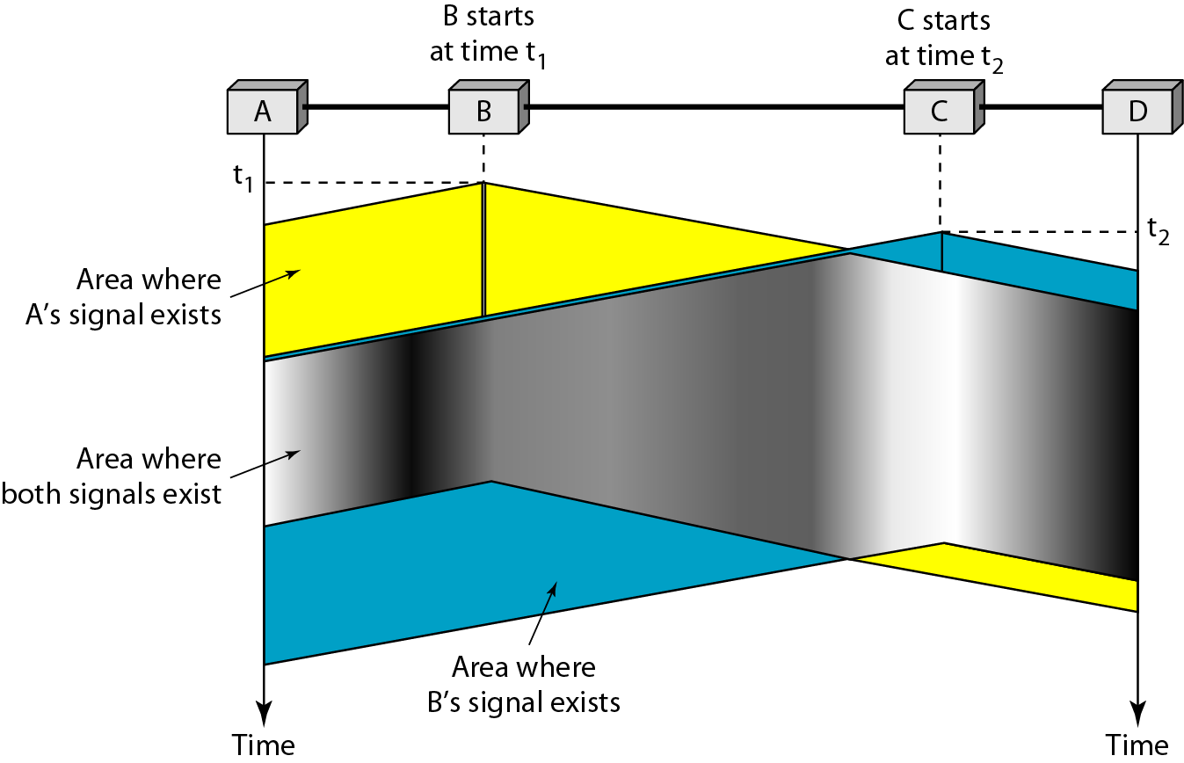
Space/time model of the collision in CSMA
First listen/ sense to medium

Slide 20
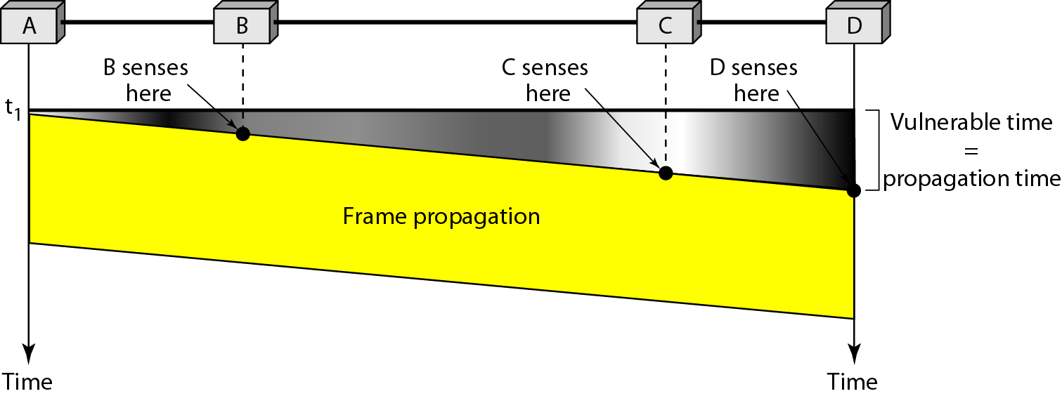
Vulnerable time in CSMA

Slide 21
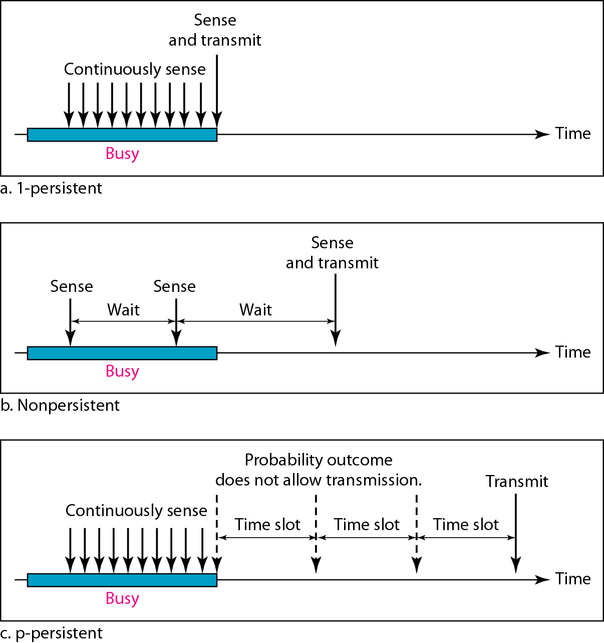
Behavior of three persistence methods

Slide 22
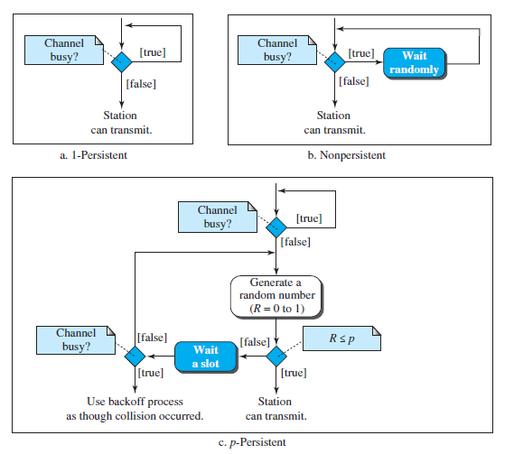
Flow diagram for three persistence methods

Slide 23
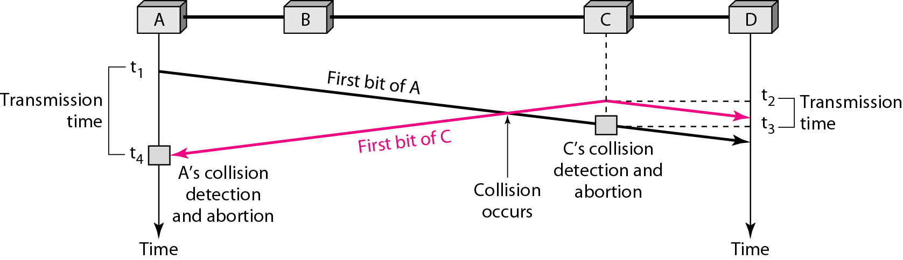
Collision of the first bit in CSMA/CD

Slide 24
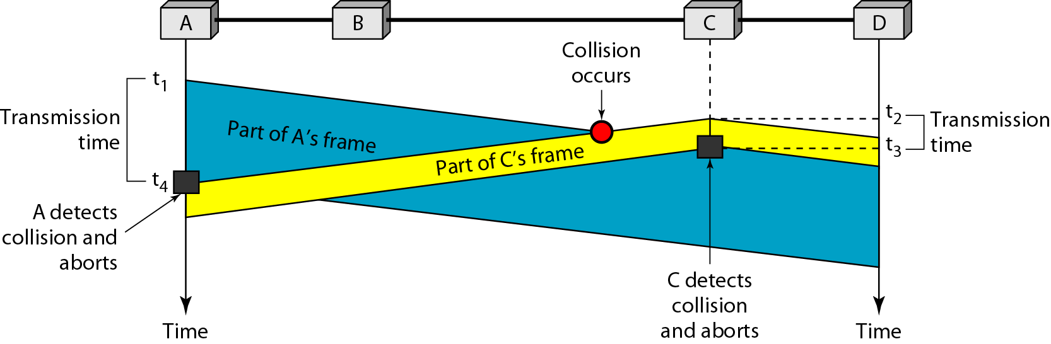
Collision and abortion in CSMA/CD

Slide 25
Example
A network using CSMA/CD has a bandwidth of 10 Mbps. If the maximum propagation time is 25.6 μs, what is the minimum size of the frame?
T_{fr} = 2 × Tp = 51.2 μs.
This means, in the worst case, a station needs to transmit for a period of 51.2 μs to detect the collision.
Min frame size = 10 Mbps × 51.2 μs = 512 bits or 64 bytes.

Slide 26
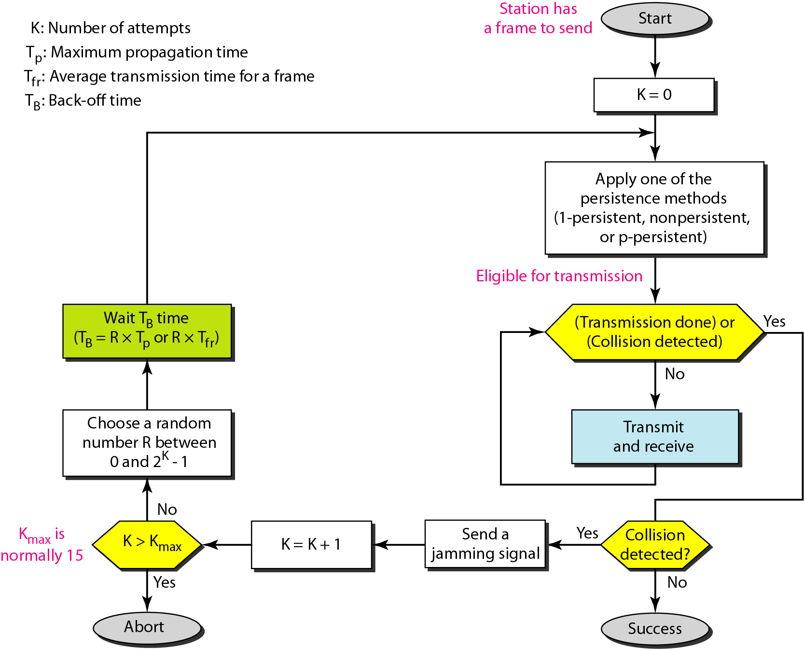
Flow diagram for the CSMA/CD

Slide 27
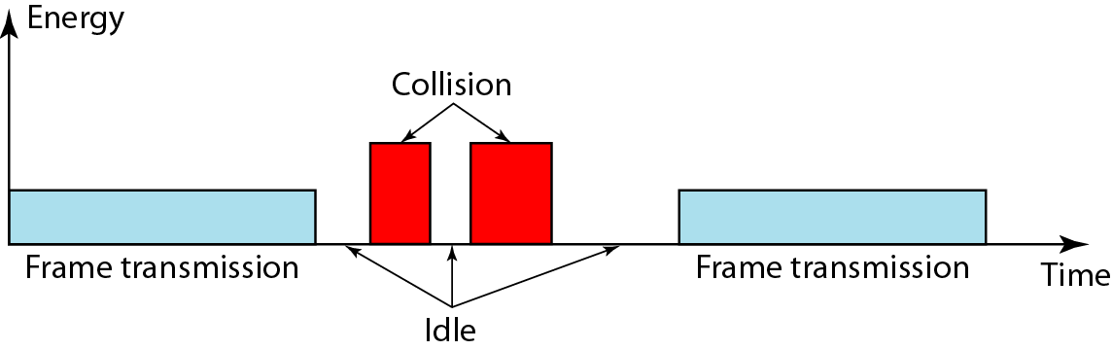
Energy level during transmission, idleness, or collision

Slide 28
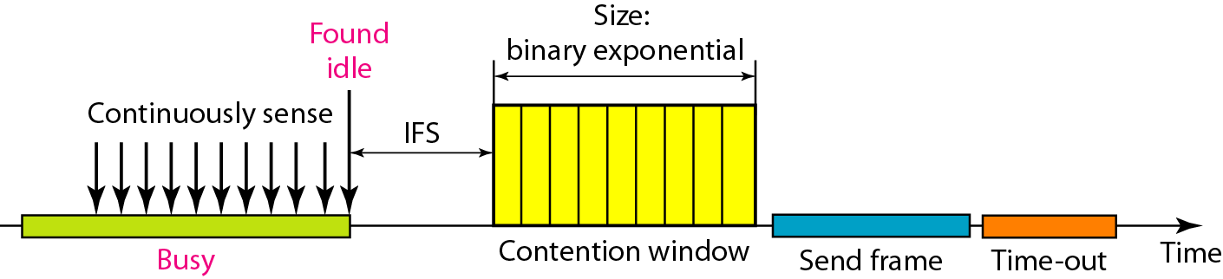
CSMA/CA

Slide 29
Note
In CSMA/CA, the IFS can also be used to define the priority of a station or a frame.

Slide 30
Note
In CSMA/CA, if the station finds the channel busy, it does not restart the timer of the contention window;
it stops the timer and restarts it when the channel becomes idle.

Slide 31
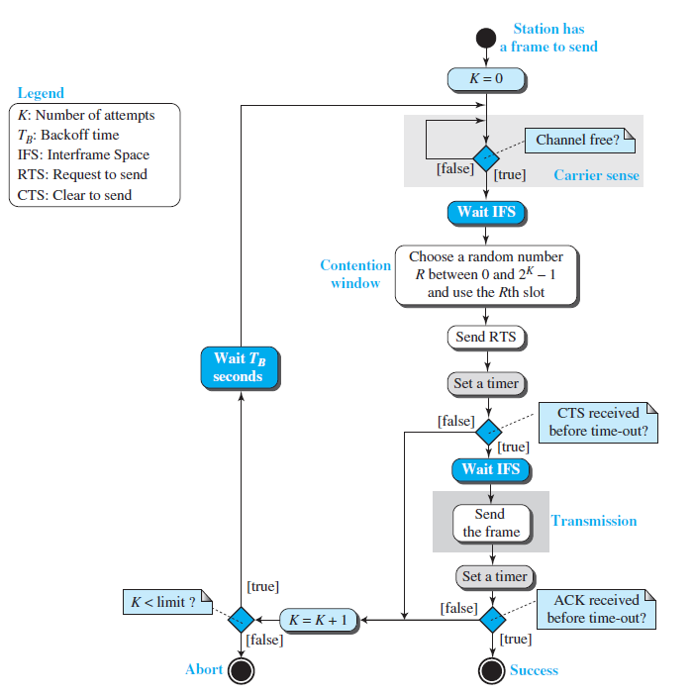
Flow diagram for CSMA/CA

Slide 32
Collision during handshaking
NAV
Hidden station problem

Slide 33
CHECK YOUR UNDERSTANDING
Which MAC Protocol is used in wireless networks
How is hidden station problem rectified
What is the vulnerable time for CSMA
How priorities are assigned in CSMA/CA

Slide 34
Outcome
Student should be able to
The random access protocols such as ALOHA, CSMA, CSMA-CA,CSMA-CD

Slide 35
THANK YOU

